Slide 1

Why Shale Gas won’t work in Europe
^{And why it will}
Allen & Overy, May 29 2012
Nick Grealy
guru@nohotair.co.uk
www.nohotair.co.uk

Slide 2
Quick update from the US
Energy 2020 North America: The New Middle East

Slide 3
Shale: Recently born in the USA

Slide 4
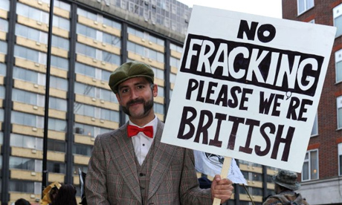
Strangled at birth in the UK…

Slide 5
Ed Davey MP
Graham Stringer: Will not the biggest impact on reducing domestic energy bills be achieved by bringing shale gas online as quickly as possible?
Mr Davey:I do not think so. We had a seminar at No. 10 recently, which the Prime Minister participated in, along with myself and the Business Secretary. We heard from experts in the shale gas industry who had been working in America and looking at the major opportunities in places such as Ukraine and China. They were clear that it would take some time for shale gas to be exploited in the UK. They were also clear that we needed strong regulation to proceed and that the shale gas reserves in this country are not quite as large as some people have been speculating.
Who did they ask?
Hansard May 17 2012

Slide 6
What the UK turns down
Cuadrilla “conservative” 200 TCF resource. 10 to 30% recoverable in US analogues. UK use 2010 of 3.2 TCF
20% = 1 TCF per year for 40 years £6Billion per year. 15% off balance of payments. £8 billion at Ofgem price predictions
Entire UK LNG imports plus one third of Norway imports or entire Netherlands imports
UK production taxed at 62% = £3.6 BN per year,
Exceed 2020 carbon targets, meet 2030 targets
Why make the perfect (2050) the enemy of the good?

Slide 7
Why shale gas won’t/will be a European game changer
Europe is too crowded (Oxford Institute of Energy Studies December 2010).
Rural areas of Europe have similar or lower population densities than many US shale areas
Advances in well pad design mean one pad will cover greater areas
Cuadrilla 40 pads covering 463 square miles

Slide 8
Objection: Crowded Europe will object to “controversial” shale gas
A You Tube video does not equal fact
Many allegations, not a single proven case
Chemicals are not secret, common household chemicals miles away from aquifers
European regulations tougher than in USA
No history except minor accidents in the USA.
Full support from POTUS downwards
Balcombe Parish Council Report

Slide 9
Where is the damage? Where are the lawyers? Where are the payouts?
US Tort Law system very efficient at protecting rights of property and health of persons
Quicker, easier and more financially damaging than regulatory systems.
Yet not one single case even makes it to trial
The buck stops there: Lloyd’s of London name finds no cause for concern on fracking April 2012 http://www.willis.com/Documents/Publications/Industries/Energy/10396_EMR%202012_Complete.pdf

Slide 10
European Geology is different
All geology is different
Every shale in North America is different. Every shale in Poland, China, Argentina and Oz is different.
There is no simple, easy secret sauce recipe for initial shale exploration
But shale gas development is far cheaper and easier than even in 2011. Europe has several advantages in the development stage
Single mineral rights ownership, largest gas market, rule of law

Slide 11
Objection: Shale is too expensive
2009: Four wells per pad with 2500 feet average laterals
2012: Up to 200 wells and 5 mile laterals
2009: Average drilling time: 3 weeks, 30 hour frack job
2012: 6 days and four hours.
2009 $ 4.50 MMBTU. Chatham House: US market will collapse if prices don’t reach $6-7MMBTU
2012: $2.33 Average from January.

Slide 12
Not enough infrastructure
There is not a large European service industry, this will slow down shale from months to years.
But, there is not (yet) large European service industry demand.
Why would a business not serve a need?
US: Less drilling rigs, yet far higher production
Europe has huge pipeline system, easier to bring gas to market than in the USA.

Slide 13
No Hot Air
Don’t you wish you had heard this four years ago?
What do I know today?
Nick Grealy
guru@nohotair.co.uk

