Slide 1
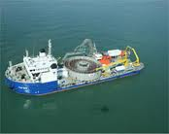
Outline of NorthConnect Interconnector
Project
London – 3rd July
Sam Peacock, Head of UK and EU Public Affairs, SSE

Slide 2
Agenda
Project Overview
UK Perspective
EU Perspective
Norway Perspective

Slide 3
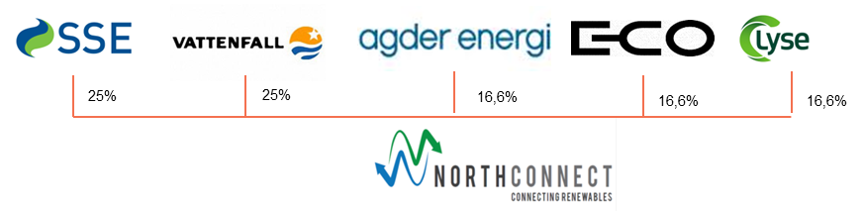
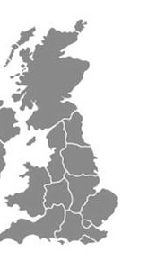
Project Overview
Mission: Connecting renewables
Five owners: UK-Nordic partnership
Non-TSO interconnector with open access
1400 MW / 600 km
Investment of 1.5-2 billion euro
Operational by 2020
Enhance security of supply by connecting renewables
Applied for recognition as an EU ‘Project of Common Interest’ (PCI)
Awarded 690k euro TEN-E funding
Samnanger/Sima
Peterhead
“It is a high priority for both governments to support the development of more interconnectors […]”
UK and Norwegian prime ministers June 7th 2012
3
3
Notes:
3
NC is a JV that aims to develop, construct and operate an HDVDC interconnector between Norway and UK.
The interconnector will enable exchange of hydro and wind power and thereby contribute to a cost efficient realisation of the renewable targets. It will bring significant benefits to both energy systems
NC is planned as non-TSO interconnector with open access and 1400 MW capacity
Large investments in the range of 1.5-2 billion Euros
The owners of NC JV are SSE, Vattenfall and leading Norwegian hydro power producers. They are reputable energy market players with necessary financial capacity and skills for execution of such large infrastructure projects.
In addition, the NC owners have established an empowered project organisation with complementary skills in order to secure efficient and fast project execution.
Having support of UK and Norwegian prime-ministers, as indicated by the quote
Applied for recognition as PCI under the new European Infrastructure Package
Awarded funding under its predecessor, the TEN-E programme

Slide 4
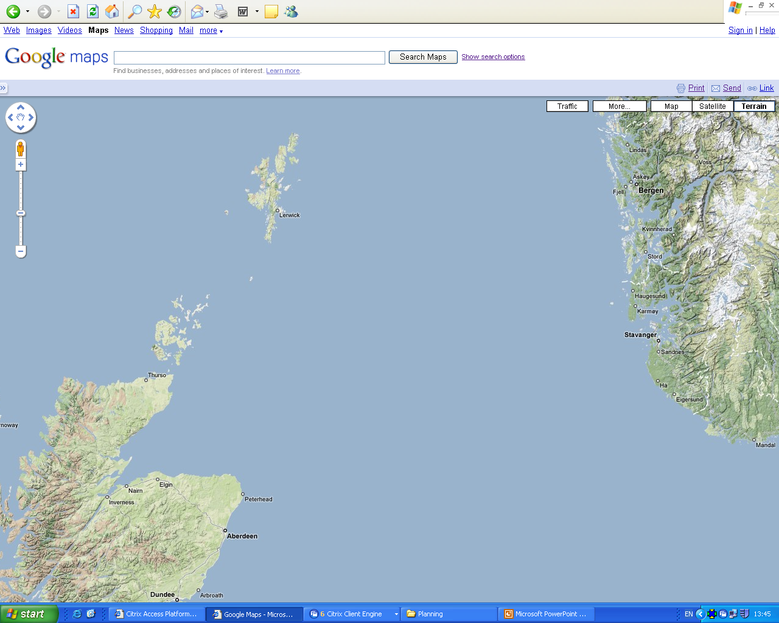


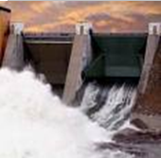




UK
Nordic
Dominated by thermal power (24h production -> daily price fluctuations)
Increase of wind power - need for flexibility / storage
Dominated by hydropower (flexible production -> seasonal price fluctuations)
Dry years are a problem
50% of European storage
+
-
Direction of Energy Exports
Storage for night time production
At day
Daily
+
During night
-
Clean water power replaces thermal energy
In dry periods
Seasonal
In wet periods
+
-
+
-
Additional energy will be stored
Windy
Wind / Hydro Interoperability
Calm

Slide 5
Why are we developing NorthConnect Interconnector ?
Security of supply
Increasing Security of supply in Nordic, UK and the EU
Compensating for fluctuations in UK wind energy production through import of Nordic hydro power
Compensate for low Nordic precipitation and low hydro storage level.
Green battery
Large amounts of wind power will be built in North Europe and NC facilitates a cost efficient integration of this renewable energy with Nordic as a green battery for UK.
.Enables import of clean Nordic hydro power in order to replace UK thermal power production and consequently the long term realisation of a low carbon energy supply
Market
integration
Leads to increased power exchange and competition in European energy markets
Optimising costs in the European energy system
Decreases price volatility in both UK and Nordic markets
Commercial
opportunity
NorthConnect consider this investment to be a promising business opportunity for
the owners, although it contains significant risk.
The project is socio-economically attractive for society
5

Slide 6
Timing

Slide 7
NorthConnect on track and moving forward
Project Status
Grid connection UK:
    Grid Offer assessment ongoing.
Grid connection Norway:
    Discussions with Norwegian TSO (Statnett) ongoing.
Environmental studies UK: Contracted
Environmental studies Norway: Contracted and started
Route study - being contracted
Technical overview plan – completed
Support from Scottish Gov. and EU (TEN-E)

Slide 8
UK context
DECC Approach
UK Government supportive of interconnection (although thrown in with DSR and storage)
Unclear how interconnectors will participate in final capacity mechanism (special case?)
DECC supportive of projects but not “picking winners”
DECC is developing position on interconnectors at present
Ministerial support for Supergrid and North Sea initiative
Ofgem
Developing regime around cap and floor
Keen to avoid exemptions
NEMO the ”test-bed”
8

Slide 9
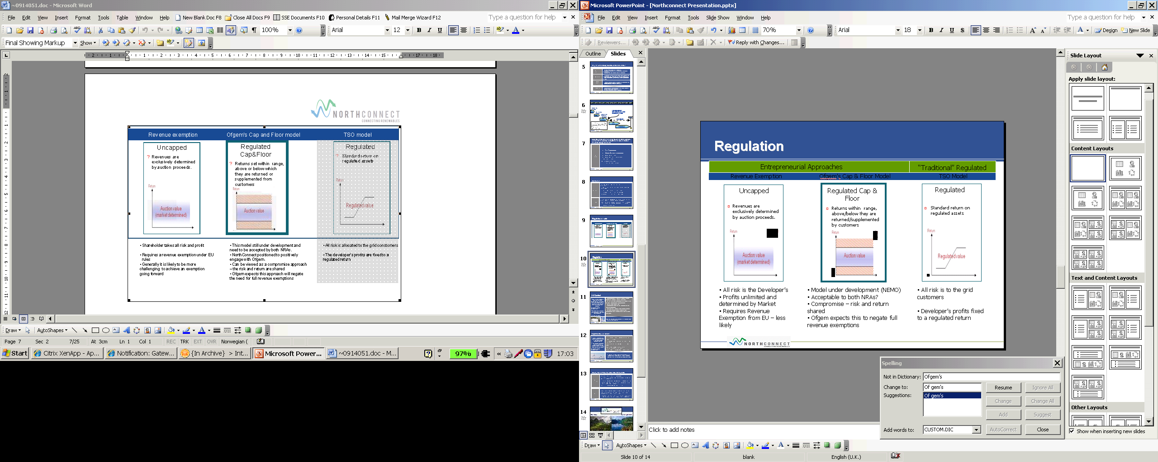
Regulated models

Slide 10
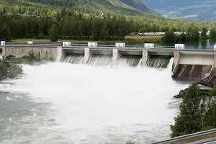
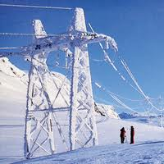
EU Context
“Major efforts are needed to modernise and expand Europe’s energy infrastructure and to interconnect networks across borders to meet the Union’s core energy policy objectives.”
Infrastructure Regulation
COM(2011) 658
“We should not be obstructing the development of Merchant Interconnectors”,
Philip Lowe, DG Energy
Requires investments of 140 billion euro by 2020 in transmission (domestic grid, connecting offshore wind farms and ICs
Current Ten Year Network Development Plan 2012 implies a 2-4 fold increase in investments compared to the last decade
Search for private capital is difficult
Move towards market integration and Target Model - Links two important energy markets
Rapid integration of renewables in the European energy system
ICs between Norway-UK/Scotland are considered to be socioeconomically viable projects and should be supported by both governments
Both TSO and non-TSO interconnectors are needed to meet EU energy policy objectives.
10
Notes:
Why do we need non-TSO interconnectors?
The Commission has estimated an investment need of 140 billion euro up to 2020, for electricity infrastructure only
This is 2-4 times as much as the previous decade
Put this into the context of budgetary constraints of all EU member states.
Can we really expect the tax payer to make these investments?
There is a clear need for private capital if we are ever going to meet this investment challenge.
On top of this, with non-TSO interconnectors you are moving the risk away from the tax payer to the market.
SOCIALLY
There is no difference between TSO and non-TSO interconnectors in terms of the service and value provided to society.
Also important is that non-TSO interconnectors are a consequence of what society needs and not a consequence of political and national interest of certain member states.
NorthConnect will link two important energy markets: UK and Irish on the one hand and the Nordic market (Sweden, Denmark, Finland and Norway) on the other hand. Having an effect on five EU member states!
ENVIRONMENTALLY
The development of more Interconnectors enables share of renewable resources which are important for reaching ambitious climate change targets and deliver valuable benefits for society.
Takeaway
With TSO and non-TSO interconnectors it is not either-or, but both-and.
But TSO’s have a major challenge in upgrading the on-shore grids. NorthConnect, can complement their efforts by focussing offshore.
Given the challenge Europe faces, we need both TSO and non-TSO interconnectors. They must be welcomed and stimulated.
10

Slide 11

Projects of Common Interest
“Projects of common interest shall be allocated the status of the highest national significance possible”
“...the respective competent authorities shall take all necessary steps for efficient cooperation and coordination”
Infrastructure Regulation
COM(2011) 658
PCI projects should benefit from streamlined permitting and consenting procedures
Projects selected as PCIs may be eligible for limited European financial support
The draft Regulation identifies twelve priority corridors and areas.
The European Commission is identifying a first group of potential PCIs in advance of the formal adoption
This process would be repeated every two years once the Regulation is in force.
For non-TSO projects, such as NorthConnect, it is essential to be recognised as Project of Common Interest in order to overcome the existing challenges
11
Notes:
There are tree clusters of challenges when realising non-TSO interconnectors:
Permitting:
Predictable and transparent conditions are of high importance
Development phase of many years including a cumbersome permitting process and operational phase of several decades
Make sure relevant stakeholders are aware of the need to support both public and private investments
Economics:
Return on investment needs to reflect the substantial level of risk for interconnector projects
Revenue estimates are quite uncertain and the duration of the lifetime for the investment gives room for a large span in actual ROI
How a revenue regulation regime is adjusted over operational phase needs to be considered carefully in order to secure correct incentives to apply at all time
Regulatory:
Simplification of permitting and grid connection processes
Regulatory regime should be aligned with regulatory bodies in neighbouring countries to simplify the permitting part of the interconnector projects
Relevant countries should be involved in the process to agree upon adequate revenue regulation regime.
Crucial to safeguard that non-TSO projects are assessed on equal terms as TSO-projects regarding getting PCI status
Proper implementation of 3rd energy package
Not clear that TSO’s always have the right incentive to think innovatively to speed-up connection of non-TSO interconnectors. It’s important that the regulators play a role in that context and proper implementation of the 3rd package can secure this.
11

Slide 12
Norway context – Low commitment for interconnection
Energy politics
Adopted EU Energy politics through EEA- agreement
Norwegian Hydro Power mainly State owned - Fragmented power sector and need for big investments
Green certificate market recently been established, will create energy surplus
“Balanced” development of interconnectors, which balances the concerns for industry, power sectors and consumers.
Although Norway viewed as a green battery for Europe
MOPE
The Norwegian Government is basically positive to new interconnectors,
The current minister of MOPE is not a supporter of non TSO projects: “If cables are to be built, they should be built by the TSO”
“ This is partly due to the principle of unbundling, and partly to view that the income from the interconnector should be used for new grid investments
12

Slide 13

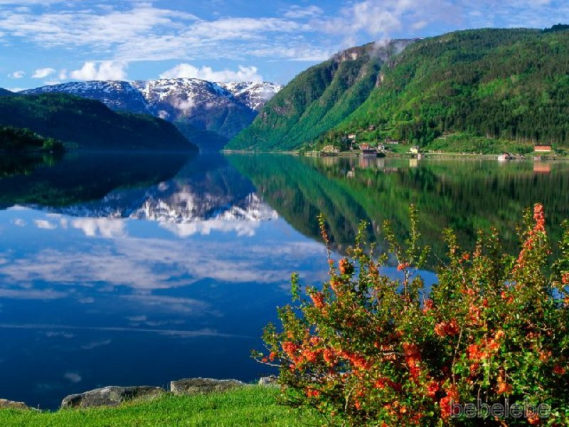
Glen Coe
Hardanger Fjord
“From Wind to Hydro and back”
13
13
Notes:
13

