Slide 1
Energy storage revenues
The future of gas and electricity storage
Asheya Patten
11 November 2014

Slide 2
PÖYRY IS EUROPE’S LEADING ENERGY MANAGEMENT CONSULTANCY
Europe’s leading management consultancy company specialising in the energy sector
Offering expert advice from strategy to implementation on policy, regulation, business operations, financing and valuation and sustainability
Providing in-depth market intelligence across Europe
Over 200 energy market experts
in 14 offices across Europe:
  Oxford – Düsseldorf – Helsinki
  London – Madrid – Milan
  Moscow – Oslo – Zurich
  Paris – Stockholm – Stavanger
  Vienna – Villach
Pöyry offices
Pöyry Management Consulting energy offices
(c) grafikdienst.com
Notes:
Poyry Energy Consulting
© 2010 Pöyry Energy (Oxford) Ltd
2

Slide 3
Increased levels of renewables leads to dramatically rising requirements for flexibility in GB power sector at national, local and company level
Annual volumes of Imbalances within-day
Annual sources of imbalance increase with rising penetration of renewable on the system
Wind should become the dominant source of error within-day
Volumes and types of actions needed at all levels to balance the system/portfolio will change
This leads to an increase in the annual volumes of flexibility needed by system
Adopting greater levels of flexibility provision will reduce the costs to secure decarbonisation of the GB energy system – thus benefitting consumers

Slide 4
Sources of flexibility
Due to scale of requirements - in the longer term all sources of flexibility are needed to manage intermittency and electrification
There are four major sources of provision of flexibility – electricity storage is the most diverse
Future of gas and electricity conference

Slide 5
Energy storage has many forms and capabilities
Mapping technologies to characteristics
Can broadly be categorised on characteristics such as power rating and dis/charge durations, but not everything falls into a discrete category
Long discharge duration, low power rating
Long discharge duration, high power rating
Short discharge duration, low power rating
Short discharge duration, high power rating
Lithium ion batteries
Pumped hydro
Batteries
CAES
High energy super-capacitors
Flow batteries
High power fly wheels
High power super-capacitors
SMES
Larger scale storage most suited to managing national issues e.g. large scale RES; smaller scale storage most suited to addressing local issues e.g. PV and EV

Slide 6
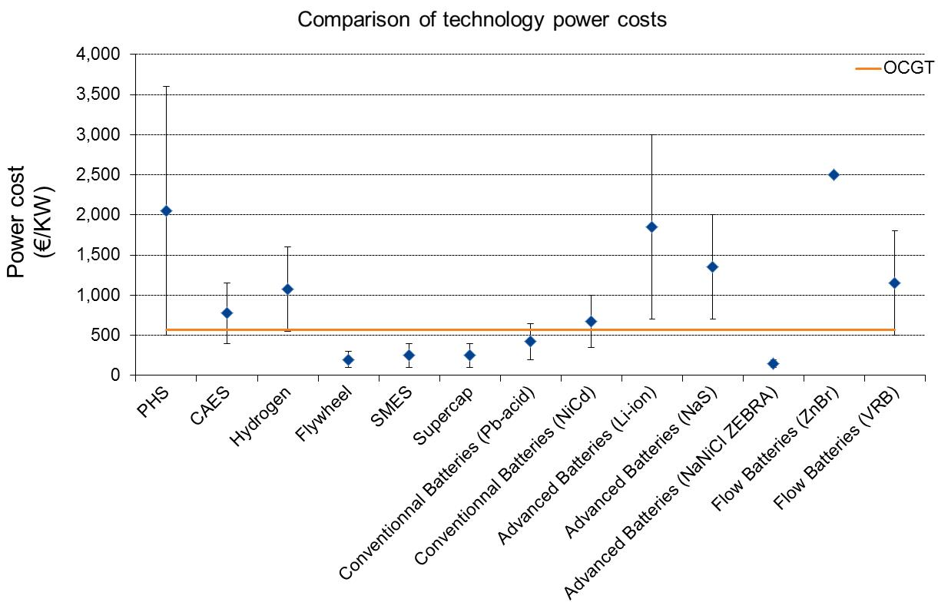
Currently the cost of storage can be significant especially compared to other flexible technologies such as OCGTs
Technology costs (€/kw)
HOWEVER significant cost economies are expected in the future as the technologies develop and commercial deployment escalates – to realise these consumer benefits it is important to support this development e.g. through innovation funding

Slide 7
However, storage could be used for a number of purposes in GB
Potential services cover the full value chain
Generation
Reduce imbalances as part of a portfolio
Network
To optimise network reinforcement
Ancillary services
To contribute to ancillary services requirements
Generate revenues through arbitrage
To contribute to quality of supply targets
To reduce the need for additional capacity
Supply
Wholesale hedging requirements
Displace higher carbon generation capacity
Diverse range of use for storage facilities but storage is not recognised as an asset class on its own and by default is treated as a generator

Slide 8
A number of business models for storage ownership and operation are available – could maximise the value of storage to the system
Storage business models – from DNO perspective
DNO merchant including trading (builds, owns and operates asset)
DNO has a more DSO role (active within wholesale market under incentive scheme)
DNO agrees long term contract but does not own storage
Providing network services only
DNO agrees long term contract with 3rd party (DNO ownership)
DNO sets DUoS charges to create signals for peak shaving that reflect value of reinforcement
1
2
3
4
5
6
Other business models include ownership and/or operation by supplier/generator/PPA providers, aggregators as well as third party storage operators/developers

Slide 9
Thus in theory storage could access a number of revenue streams
This in turn allows - in theory - stacking different revenue streams to create a total value proposition
STORAGE REVENUES
STOR
Fast Reserve
Arbitrage opportunities in wholesale market
Capacity Payment
Frequency Response
Potential for Network CAPEX
The level and accessibility of all of these revenue streams are influenced by policy decisions made by UK Government and Ofgem

Slide 10
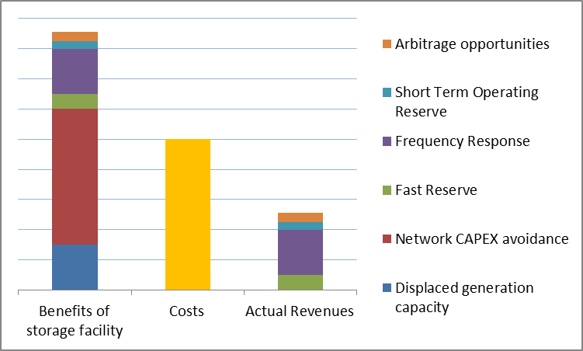
In reality some revenue streams are accessible and others not
Costs and Benefits of example storage facility
Not accessible
Revenues attributable to wider system benefits – which is a large part of the storage value proposition - currently are not accessible

Slide 11
Furthermore key revenue streams are in turn dependent on various policy decisions which can adversely affect income
Impact on storage
Future trading arrangements
Balancing services Review
Incentives for electrification
Hierarchy of utilisation of DSR/Storage
Smart energy framework
Capacity Payment
Cash out reform
RIIO
Storage revenues (and revenues for flexibility in general) are highly dependent on the outcome of the various policy tools being implemented in GB – thus absent or reduced rewards for flexibility will undermine development of energy storage

Slide 12
Contact:
Name: Asheya Patten
Mail: asheya.patten@poyry.com
Phone: +44 1865 812 220

